Slide 1
KING COUNTY HOUSE SALES ANALYSIS

Slide 2
Overview
King County is located in the U.S. state of Washington. It is the most populous county in Washington, and the 13th-most populous in the United States. The county seat is Seattle, also the state's most populous city.

Slide 3
Business Understanding
A real estate agent of a company in Seattle(stakeholder) wants to know which factors significantly impact the prices of a house in King County. This will aid in strategizing on the best criteria to take in order to maximize on profit. I have been given the task by the company to come up with a model that will be used to predict property prices in King County and obtain significant recommendations on steps that they should take for the business to be successful.

Slide 4
Methodology
Simple Linear Regression model
Multiple Linear Regression model

Slide 5
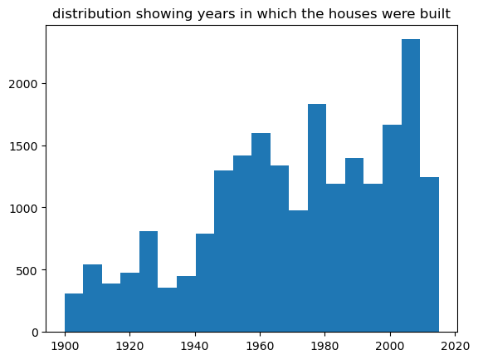
CONCLUSION

Slide 6
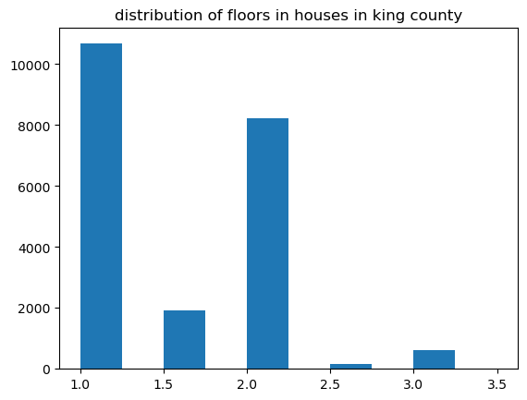
CONCLUSION

Slide 7
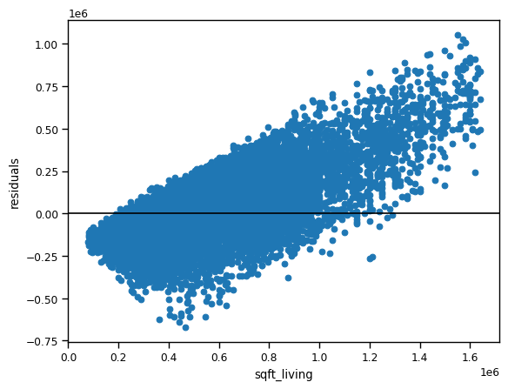

Slide 8
CONCLUSION
In the year 2014 more houses were sold as compared to hoses sold in 2015.
Most Houses in King County were sold on the 4th and 5th month of the year.
Most houses in King County had 3 bedrooms followed by 4 bedrooms per house.
Most of the houses had 2.5 bathrooms. Houses with more bathrooms and bedrooms had the highest prices.
Most of the houses had no waterfront and no view however, the houses with a waterfront and a view had the highest prices.
Most houses were in average condition and the houses with very good condition had the highest prices.
The multiple linear regression model is better than the two simple regression models as it had a higher R-squared value. This shows that categorical variables had a positive effect on the prices as illustrated in the univariate analysis.
Therefore adding these variables to the predictive model made the model to be a bit stronger.

Slide 9
RECOMMENDATIONS
In conclusion the real estate agency should review the sqft_living, sqft_living15, sqft_above, bedrooms, bathrooms, and grade when setting their house prices as there is a linear relationship between these variables.
Factors like bathrooms, bedrooms, having a waterfront, and an excellent view have a positive effect on house prices. Lastly, the house prices seemed to have increased in 2015 they should therefore consider inflation when setting house prices in the future.

